Slide 1
More SQL
Extended Relational Algebra Outerjoins, Grouping/Aggregation Insert/Delete/Update

Slide 2
The Extended Algebra
δ = eliminate消除 duplicates重复项 from bags.
τ = sort tuples.
γ = grouping and aggregation.
Outerjoin: avoids “dangling tuples” = tuples that do not join with anything.

Slide 3
Duplicate Elimination
R1 := δ(R2).消除重复项
R1 consists由 组成of one copy of each tuple that appears in R2 one or more times.

Slide 4
Example: Duplicate Elimination
R = ( A
1
B ) 2
3
1
4
2
δ(R) =
A
B
1
3
2
4

Slide 5
Sorting
R1 := τ_{L} (R2).
L is a list of some of the attributes of R2.
R1 is the list of tuples of R2 sorted first on the value of the first attribute on L, then on the second attribute of L, and so on.
Break ties arbitrarily.
τ is the only operator whose result is neither a set nor a bag.

Slide 6
Example: Sorting
R = ( A
1
B ) 2
3
5
4
2
τ_{B} (R) = [(5,2), (1,2), (3,4)]

Slide 7
Aggregation Operators聚合运算符
Aggregation operators are not operators of relational algebra.
Rather, they apply to entire columns of a table and produce a single result.
The most important examples: SUM, AVG, COUNT, MIN, and MAX.

Slide 8
Example: Aggregation
R = ( A
1
B ) 3
3
3
4
2
SUM(A) = 7
COUNT(A) = 3
MAX(B) = 4
AVG(B) = 3

Slide 9
Grouping Operator分组运算符
R1 := γ_{L} (R2). L is a list of elements that are either:
Individual (grouping) attributes.
AGG(A), where AGG is one of the aggregation operators and A is an attribute.
An arrow and a new attribute name renames the component.

Slide 10
Applying γ_{L}(R)
Group R according to all the grouping attributes on list L.
That is: form one group for each distinct list of values for those attributes in R.
Within each group, compute AGG(A) for each aggregation on list L.
Result has one tuple for each group:
The grouping attributes and
Their group’s aggregations.

Slide 11

Example: Grouping/Aggregation
R = ( A
1
B 2
C )
3
6
5
Then, average C
within groups:
4
1
5
2
A 1
B 2
X 4
γA,B,AVG(C)->X ^{(R) = ??}
First, group Rby Aand B:
4
5
6
A | B | C
1 | 2 | 3
1 | 2 | 5
4 | 5 | 6
11

Slide 12
Outerjoin
Suppose we join R⋈_{C}S.
A tuple of R that has no tuple of S with which it joins is said to be dangling.
Similarly for a tuple of S.
Outerjoin preserves dangling tuples by padding them NULL.

Slide 13
Example: Outerjoin
R = ( A
1
B ) 2
S = ( B
2
C ) 3
4 5 6 7
(1,2) joins with (2,3), but the other two tuples are dangling.
R OUTERJOIN S = | A | B | C
 | 1 | 2 | 3
 | 4 | 5 | NULL
 | NULL | 6 | 7

Slide 14
Now --- Back to SQL
Each Operation Has a SQL Equivalent

Slide 15
Outerjoins
R OUTER JOIN S is the core of an outerjoin expression. It is modified by:
Optional NATURAL in front of OUTER.
Optional ON <condition> after JOIN.
Optional LEFT, RIGHT, or FULL before OUTER.
Only one of these
LEFT = pad dangling tuples of R only.
RIGHT = pad dangling tuples of S only.
FULL = pad both; this choice is the default.

Slide 16
Aggregations
SUM, AVG, COUNT, MIN, and MAX can be applied to a column in a SELECT clause to produce that aggregation on the column.
Also, COUNT(*) counts the number of tuples.

Slide 17
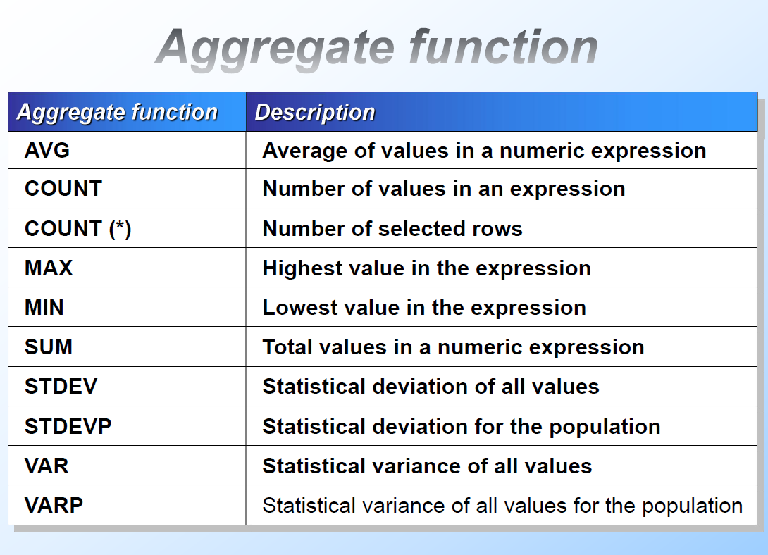
统计标准差
统计方差

Slide 18
Example: Aggregation
From Sells(bar, beer, price), find the average price of Bud:
SELECT AVG(price)
FROM Sells
WHERE beer = ’Bud’;
18

Slide 19
COUNT
统计表行数
SELECT COUNT (*) FROM employees
统计不含空值的行数
SELECT COUNT(reportsto) FROM employees

Slide 20
Eliminating Duplicates消除重复 in an Aggregation
Use DISTINCT inside an aggregation聚合内部.
Example: find the number of different prices charged for Bud:不同的
SELECT COUNT(DISTINCT price)
FROM Sells
WHERE beer = ’Bud’;

Slide 21
NULL’s Ignored in Aggregation
NULL never contributes to a sum, average, or count, and can never be the minimum or maximum of a column.
But if there are no non-NULL values in a column, then the result of the aggregation is NULL.
Exception: COUNT of an empty set is 0.

Slide 22
Example: Effect of NULL’s
SELECT count(*)
FROM Sells
WHERE beer = ’Bud’;
The number of bars that sell Bud.
SELECT count(price)
FROM Sells
WHERE beer = ’Bud’;
The number of bars that sell Bud at a known price.

Slide 23
Grouping
We may follow a SELECT-FROM-WHERE expression by GROUP BY and a list of attributes.
The relation that results from the SELECT-FROM-WHERE is grouped according to the values of all those attributes, and any aggregation is applied only within each group.

Slide 24
Example: Grouping
From Sells(bar, beer, price), find the average price for each beer:
SELECT beer, AVG(price)
FROM Sells GROUP BY beer;
beer AVG(price) Bud 2.33
…
…

Slide 25


Example: Grouping
From Sells(bar, beer, price) and Frequents(drinker, bar), find for each drinker the average price of Bud at the bars they frequent:
Compute all drinker-bar- price triples for Bud.
SELECT drinker, AVG(price)
FROM Frequents, Sells
WHERE beer = ’Bud’ AND Frequents.bar = Sells.bar
Then group them by drinker.
GROUP BY drinker;

Slide 26


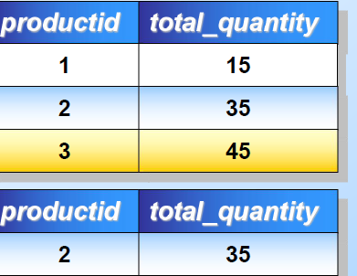
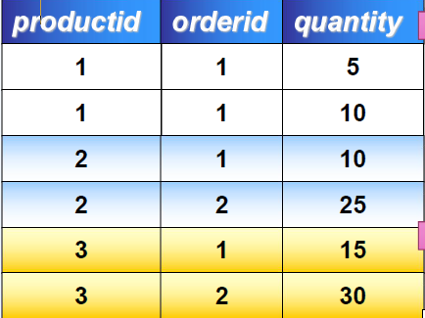








































Using the GROUP BY Clause
SELECT productid, orderid
,quantity FROM orderhist
SELECT productid
,SUM(quantity) AS total_quantity FROM orderhist
GROUP BY productid
对查询结果分组
1  使用G1 ROUP5 BY子句
1
2
3
15
35
45
1
2
先分¹ 组，然¹⁰后使用聚集函数
₁ Only rows that
10
satisfy the WHERE clause are grouped
2 | 2 | 25
3 | 1 | 15
3 | 2 | 30
2 35
SELECT productid
,SUM(quantity) AS total_quantity FROM orderhist
WHERE productid = 2
GROUP BY productid

Slide 27




Restriction on SELECT Lists With Aggregation
If any aggregation is used, then each element of the SELECT list must be either:
Aggregated, or
An attribute on the GROUP BY list.

Slide 28

Illegal Query Example
You might think you could find the bar that sells Bud the cheapest by:
SELECT bar, MIN(price)
FROM Sells
WHERE beer = ’Bud’;
But this query is illegal in SQL.

Slide 29
HAVING Clauses
HAVING <condition> may follow a GROUP BY clause.
If so, the condition applies to each group, and groups not satisfying the condition are eliminated.

Slide 30


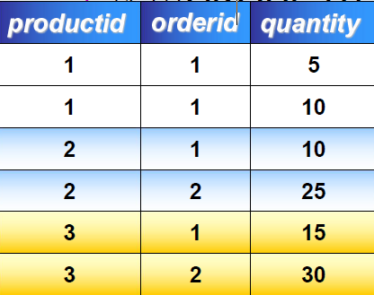









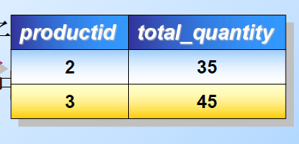























Using the GROUP BY Clause with the HAVING Clause
SELECT productid, orderid
,quantity
SELECT productid, SUM(quantity) AS total_quantity
FROM orderhist GROUP BY productid
FROM orderhist
对查询结果分组
HAVING SUM(quantity)>=30
使用GROUP BY…HAVING子句
1 1 5
¹HAVIN¹G短语¹⁰与WHERE子句的不同
2 1 10 2
35
2
3
WHERE子句作用于FROM中的基表或视图；
2 25
3
45
HAVI₁NG短语₁₅作用于组。
³ WHE²RE子句³⁰中不能使用聚集函数；而 HAVING短语中可以使用聚集函数。

Slide 31
Example: HAVING
From Sells(bar, beer, price) and Beers(name, manf), find the average price of those beers that are either served in at least three bars or are manufactured by Pete’s.

Slide 32
Solution
Beer groups with at least 3 non-NULL bars and also beer groups where the manufacturer is Pete’s.
SELECT beer, AVG(price) FROM Sells
GROUP BY beer
HAVING COUNT(bar) >= 3 OR
beer IN
(SELECT name
FROM Beers
WHERE manf = ’Pete’’s’)
Beers manu- factured by Pete’s.
;

Slide 33
Requirements on HAVING Conditions
Anything goes in a subquery.
Outside subqueries, they may refer to attributes only if they are either:
A grouping attribute, or
Aggregated
(same condition as for SELECT clauses with aggregation).

Slide 34
Database Modifications
A modification 修改 command does not return a result (as a query does), but changes the database in some way.
Three kinds of modifications:
Insert a tuple or tuples.
Delete a tuple or tuples.
Update the value(s) of an existing tuple or tuples.

Slide 35
Insertion
To insert a single tuple: INSERT INTO <relation> VALUES ( <list of values> );
Example: add to Likes(drinker, beer) the fact that Sally likes Bud.
INSERT INTO Likes
VALUES(’Sally’, ’Bud’);

Slide 36
Specifying指定 Attributes in INSERT
We may add to the relation name a list of attributes.
Two reasons to do so:
We forget the standard order of attributes for the relation.
We don’t have values for all attributes, and we want the system to fill in missing components with NULL or a default value.

Slide 37
Example: Specifying Attributes
Another way to add the fact that Sally likes Bud to Likes(drinker, beer):
INSERT INTO Likes(beer, drinker) VALUES(’Bud’, ’Sally’);

Slide 38
Adding Default Values
In a CREATE TABLE statement, we can follow an attribute by DEFAULT and a value.
When an inserted tuple has no value for that attribute, the default will be used.

Slide 39
Example: Default Values
CREATE name | TABLE Drinkers ( CHAR(30) PRIMARY | KEY,
addr | CHAR(50)
DEFAULT ’123 Sesame St.’,
phone CHAR(16)
);

Slide 40
Example: Default Values
INSERT INTO Drinkers(name) VALUES(’Sally’);
Resulting tuple:
name Sally
address
123 Sesame St
phone NULL

Slide 41
Inserting Many Tuples
We may insert the entire result of a query into a relation, using the form:
INSERT INTO <relation> ( <subquery> );

Slide 42
Example: Insert a Subquery
Using Frequents(drinker, bar), enter into the new relation PotBuddies(name) all of Sally’s “potential buddies,” i.e., those drinkers who frequent at least one bar that Sally also frequents.

Slide 43
The other drinker
Pairs of Drinker tuples where the first is for Sally, the second is for someone else, and the bars are the same.
Solution
INSERT INTO PotBuddies
(
SELECT d2.drinker
FROM Frequents d1, Frequents d2
WHERE d1.drinker = ’Sally’ AND d2.drinker <> ’Sally’ AND d1.bar = d2.bar
);

Slide 44



Creating a Table Using the SELECT INTO Statement
Use to Create a Table and Insert Rows into the
Table
in a Single Operation
Create a Local or Global Temporary Table
Set the select into/bulkcopy Database Option ON in Order to Create a Permanent Table
Create Column Alias or Specify Column Names in the Select List for New Table
SELECT productname AS products
,unitprice AS price
,(unitprice * 1.1) AS tax INTO #pricetable
FROM products

Slide 45
Deletion
To delete tuples satisfying a condition from some relation:
DELETE FROM <relation> WHERE <condition>;

Slide 46
Example: Deletion
Delete from Likes(drinker, beer) the fact that Sally likes Bud:
DELETE FROM Likes
WHERE drinker = ’Sally’ AND beer = ’Bud’;

Slide 47

Example: Delete all Tuples
Make the relation Likes empty:
DELETE FROM Likes;
Note no WHERE clause needed.

Slide 48


Example: Delete Some Tuples
Delete from Beers(name, manf) all beers for which there is another beer by the same manufacturer.
DELETE FROM Beers b WHERE EXISTS (
Beers with the same manufacturer and
a different name from the name of the beer represented by tuple b.
SELECT name FROM Beers
WHERE manf = b.manf AND name <> b.name);

Slide 49
Semantics 语义of Deletion
Suppose Anheuser-Busch makes only Bud and Bud Lite.
Suppose we come to the tuple b for Bud first.
The subquery is nonempty, because of the Bud Lite tuple, so we delete Bud.
Now, when b is the tuple for Bud Lite, do we delete that tuple too?

Slide 50
Semantics of Deletion --- (2)
Answer: we dodelete Bud Lite as well.
The reason is that deletion proceeds in two stages:
Mark all tuples for which the WHERE condition is satisfied.
Delete the marked tuples.

Slide 51


Updates
To change certain attributes in certain tuples of a relation:
UPDATE <relation>
SET <list of attribute assignments> WHERE <condition on tuples>;

Slide 52

Example: Update
Change drinker Fred’s phone number to 555-1212:
UPDATE Drinkers
SET phone = ’555-1212’
WHERE name = ’Fred’;

Slide 53
Example: Update Several Tuples
Make $4 the maximum price for beer:
UPDATE Sells SET price = 4.00
WHERE price > 4.00;

